Slide 1
Name / mahmoud yasser Osman Mohamed
Data / hr
My work
1-Do cleaning data by sql
2-Do visualize data by python
3-make questions related charts
4- do documentation
5-do presentation

Slide 2
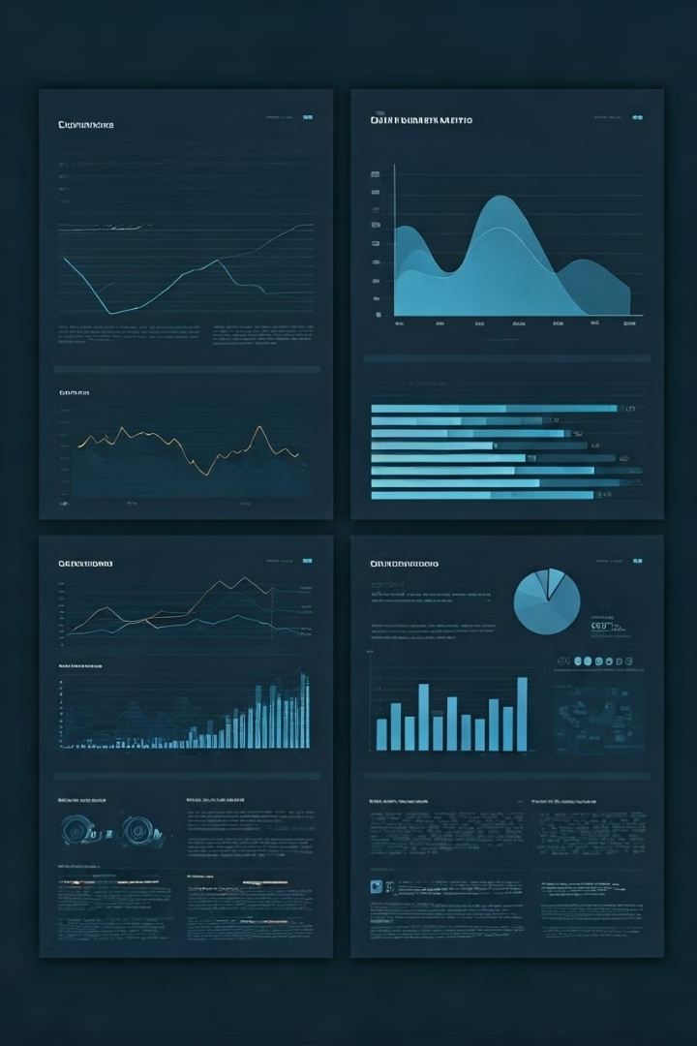


Data Analysis: Cleaning and Visualizing Data
In today's data-driven business landscape, the ability to effectively clean, analyze, and visualize data is a critical skill for professionals across industries. This presentation will guide you through the key steps of the data analysis process, from mastering SQL techniques for data cleaning to leveraging powerful Python libraries for creating compelling data visualizations.
by ENG. Mahmoud Yasser

Slide 3
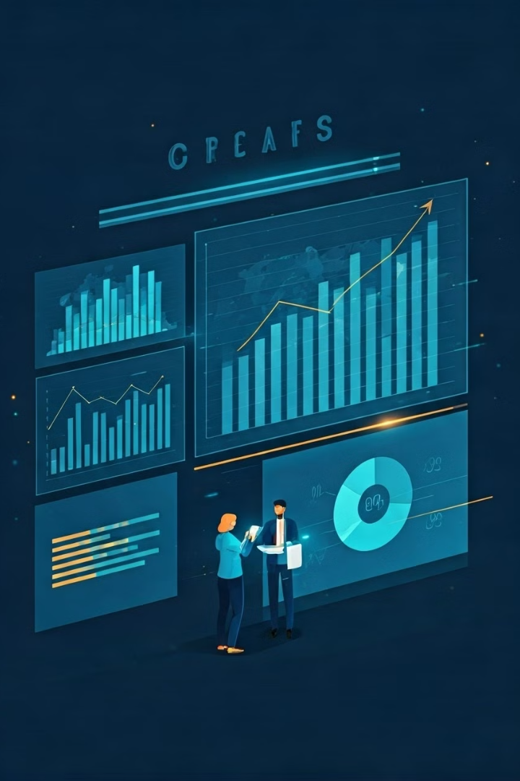
Introduction to Data Analysis
1
Data-Driven Decision Making
2
Uncovering Hidden Patterns
In a world where data is abundant, the ability to extract meaningful insights and make informed decisions is a competitive advantage. Effective data analysis is the foundation for driving business growth and innovation.
Data analysis techniques allow you to identify trends, correlations, and anomalies that may not be immediately apparent, leading to a deeper understanding of your business and its customers.
3
Improving Operational Efficiency
By identifying bottlenecks, optimizing processes, and making data-driven decisions, data analysis can help organizations streamline their operations and enhance overall productivity.

Slide 4

Importance of Data Cleaning
Data Integrity
Improved Efficiency
Informed Decision Making
By starting with a clean dataset, you can be confident in the accuracy of your analysis and the decisions you make based on it, reducing the risk of costly mistakes.
Accurate and reliable data is the foundation for any robust data analysis. Proper data cleaning ensures that your dataset is free from errors, inconsistencies, and missing values, leading to more reliable insights.
Cleaning data upfront can save you significant time and effort down the line, as you won't have to constantly worry about data quality issues or spend valuable resources on data cleansing tasks.

Slide 5

Utilizing SQL for Data Cleaning
Data Profiling
Understand the structure, quality, and characteristics of your data by using SQL functions like COUNT, MIN, MAX, and DISTINCT to identify potential issues.
Data Transformation
Leverage SQL's powerful data manipulation capabilities to clean, standardize, and format your data using functions like TRIM, REPLACE, and CAST.
Data Validation
Implement data validation checks using SQL's conditional logic (IF, CASE) and constraints (PRIMARY KEY, UNIQUE, CHECK) to ensure data integrity.

Slide 6

Key SQL Techniques for Data Cleaning
Handling Null Values
Deduplicating Data
Use the COALESCE and IFNULL functions to replace NULL values with appropriate substitutes, ensuring your dataset is complete and consistent.
Identify and remove duplicate records using the ROW_NUMBER and PARTITION BY functions, ensuring your data is free from redundancies.
Formatting Data
Validating Data
Implement data validation checks using CASE statements, LIKE patterns, and CONSTRAINT clauses to ensure the accuracy and integrity of your data.
Apply string manipulation functions like REPLACE, TRIM, and UPPER/LOWER to standardize data formats and improve readability and consistency.

Slide 7
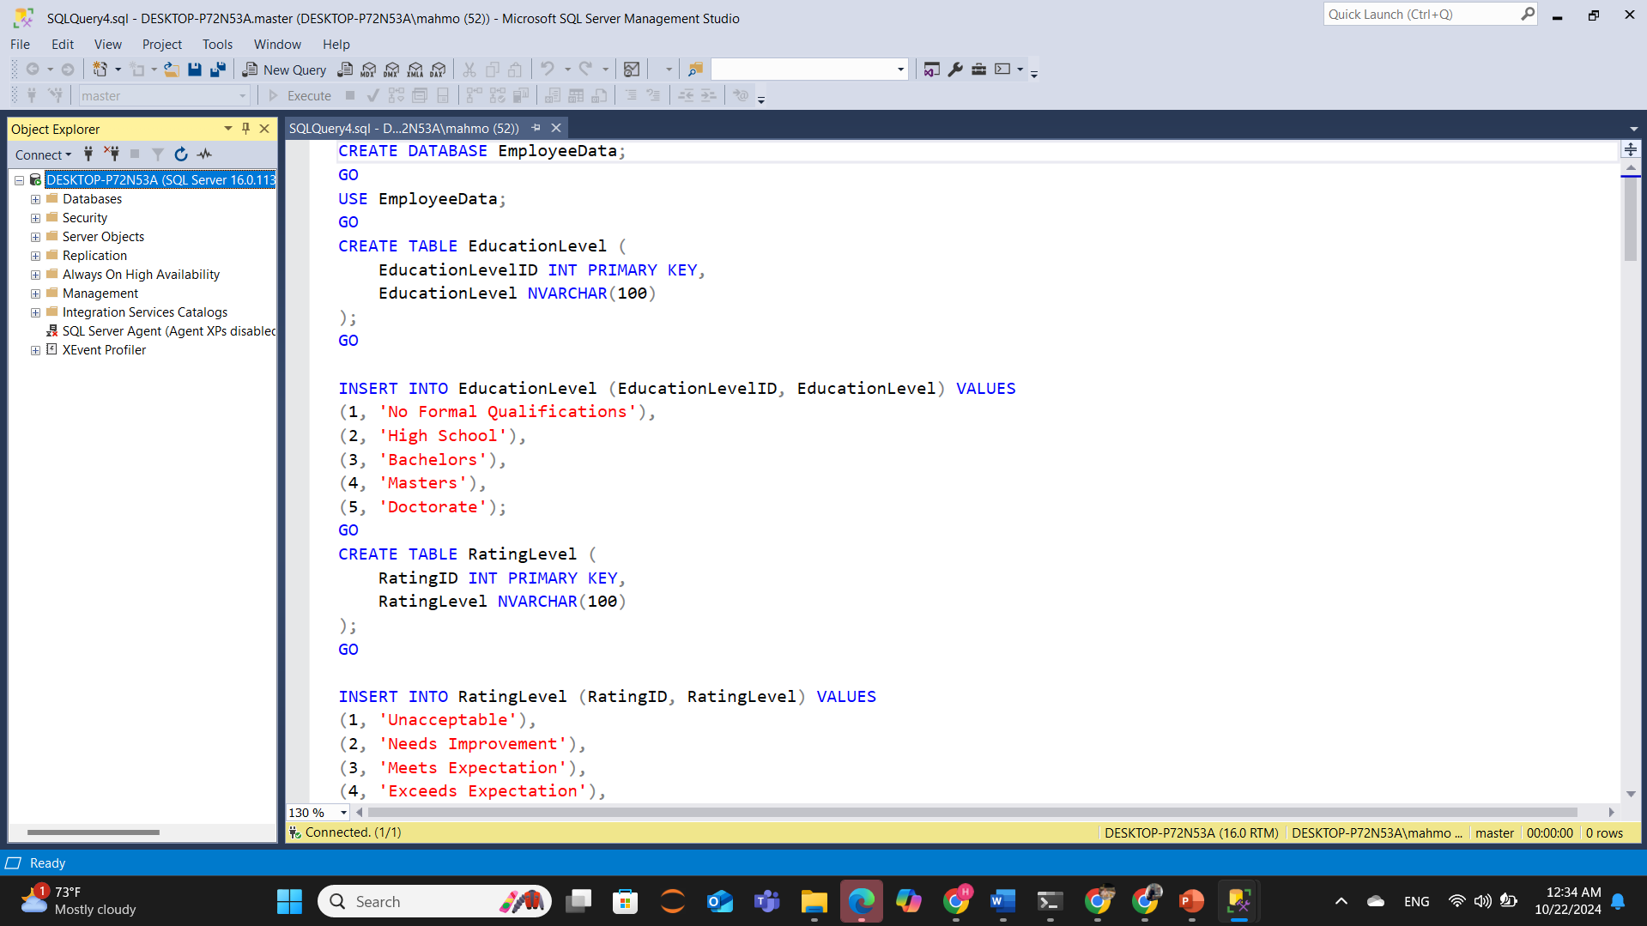

Slide 8
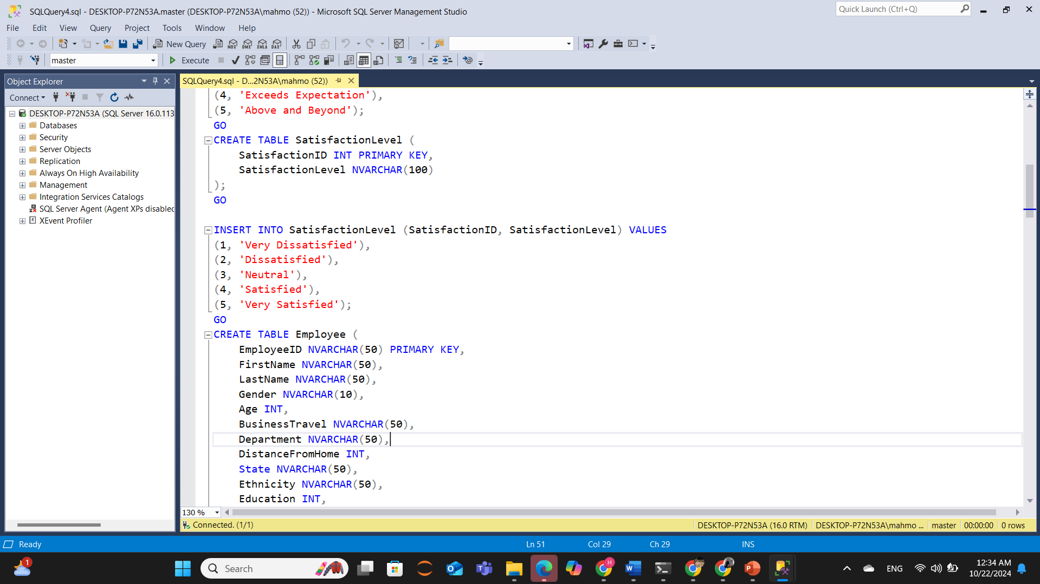

Slide 9
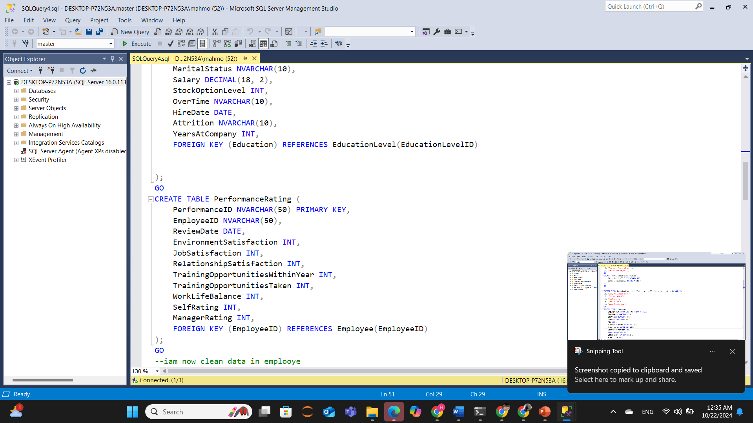

Slide 10
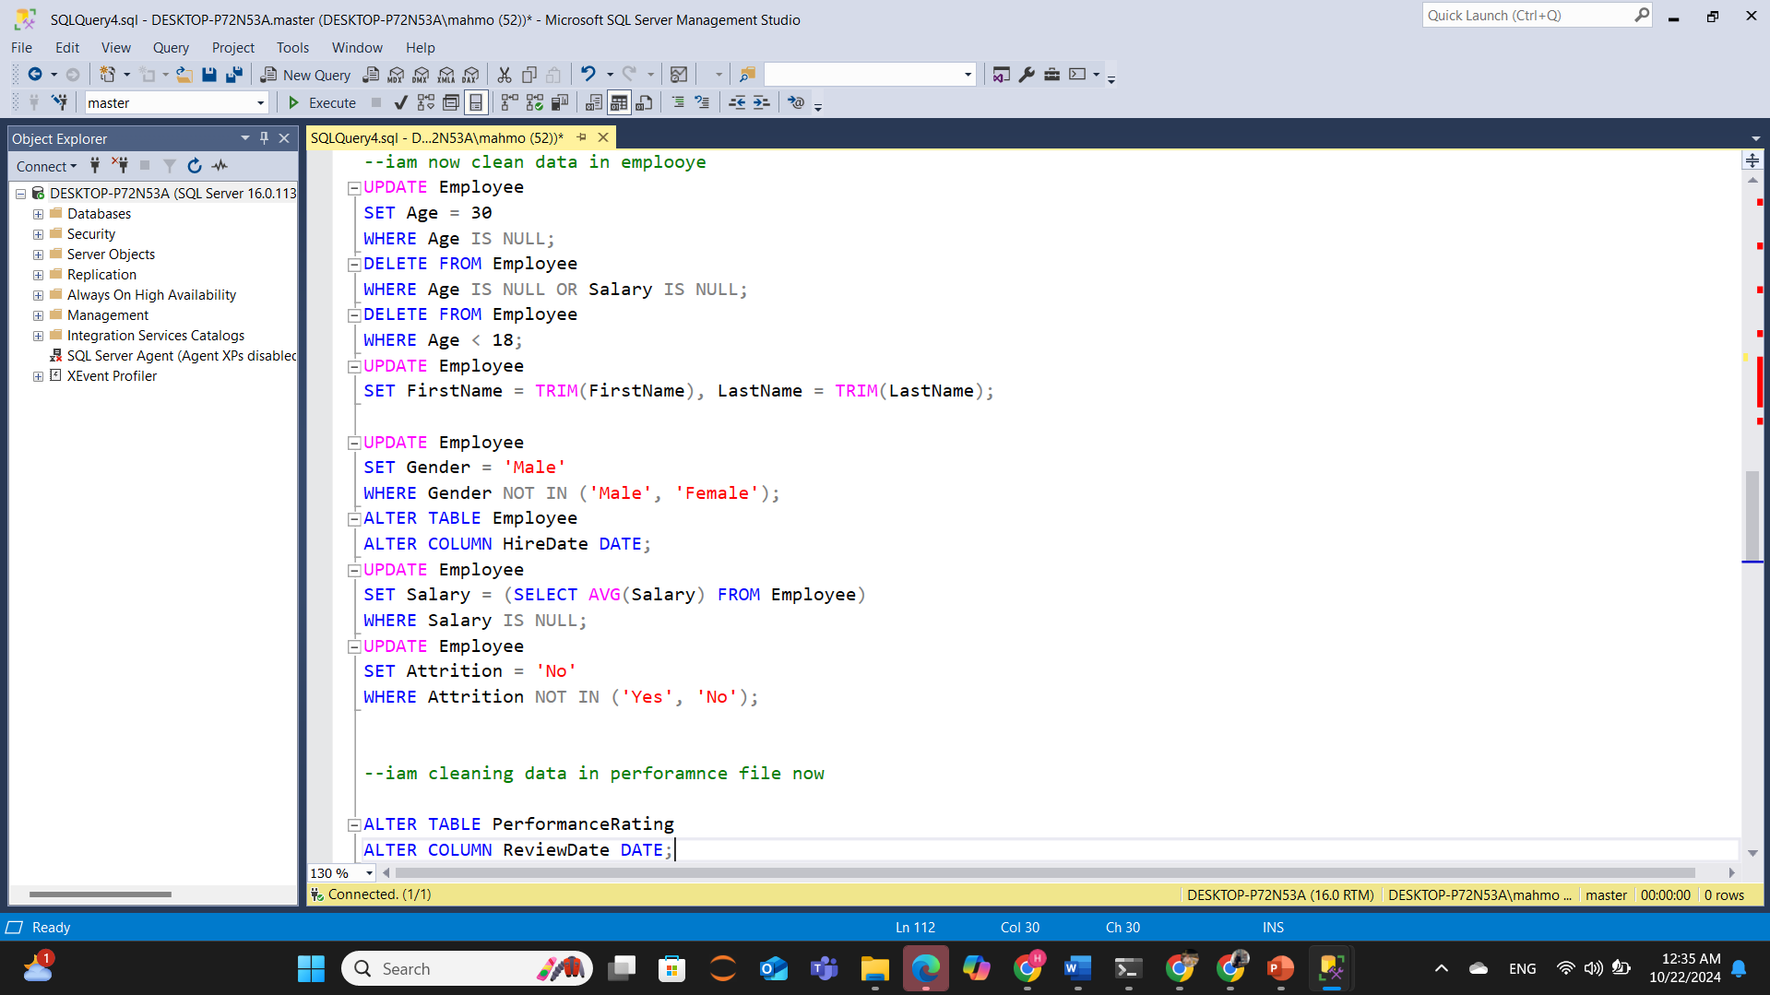

Slide 11
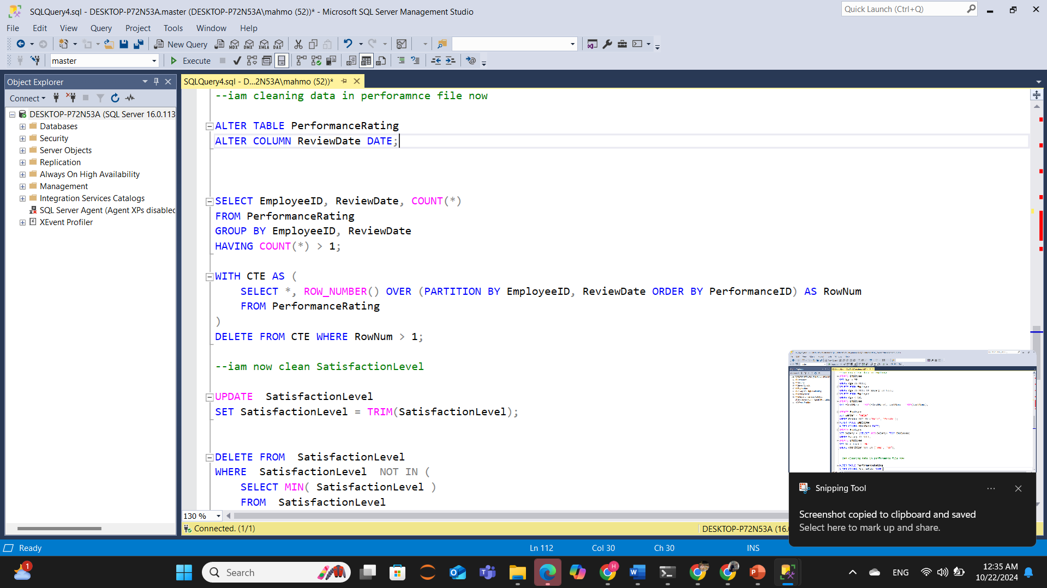

Slide 12
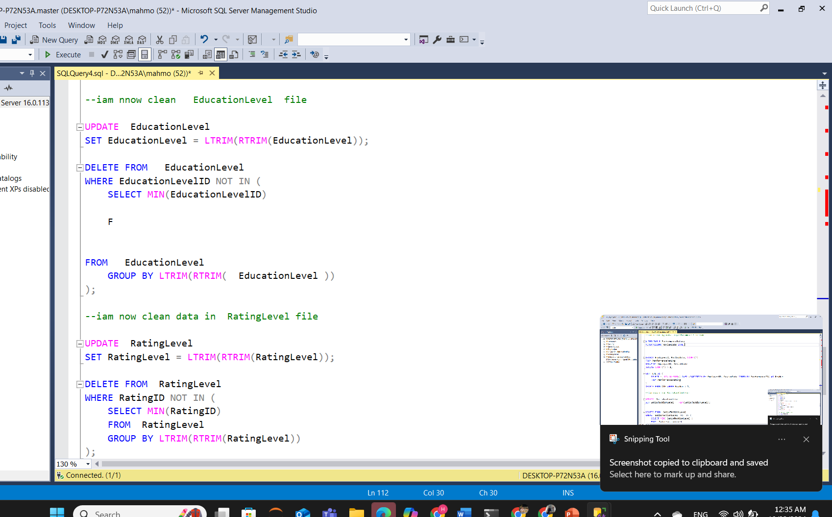

Slide 13
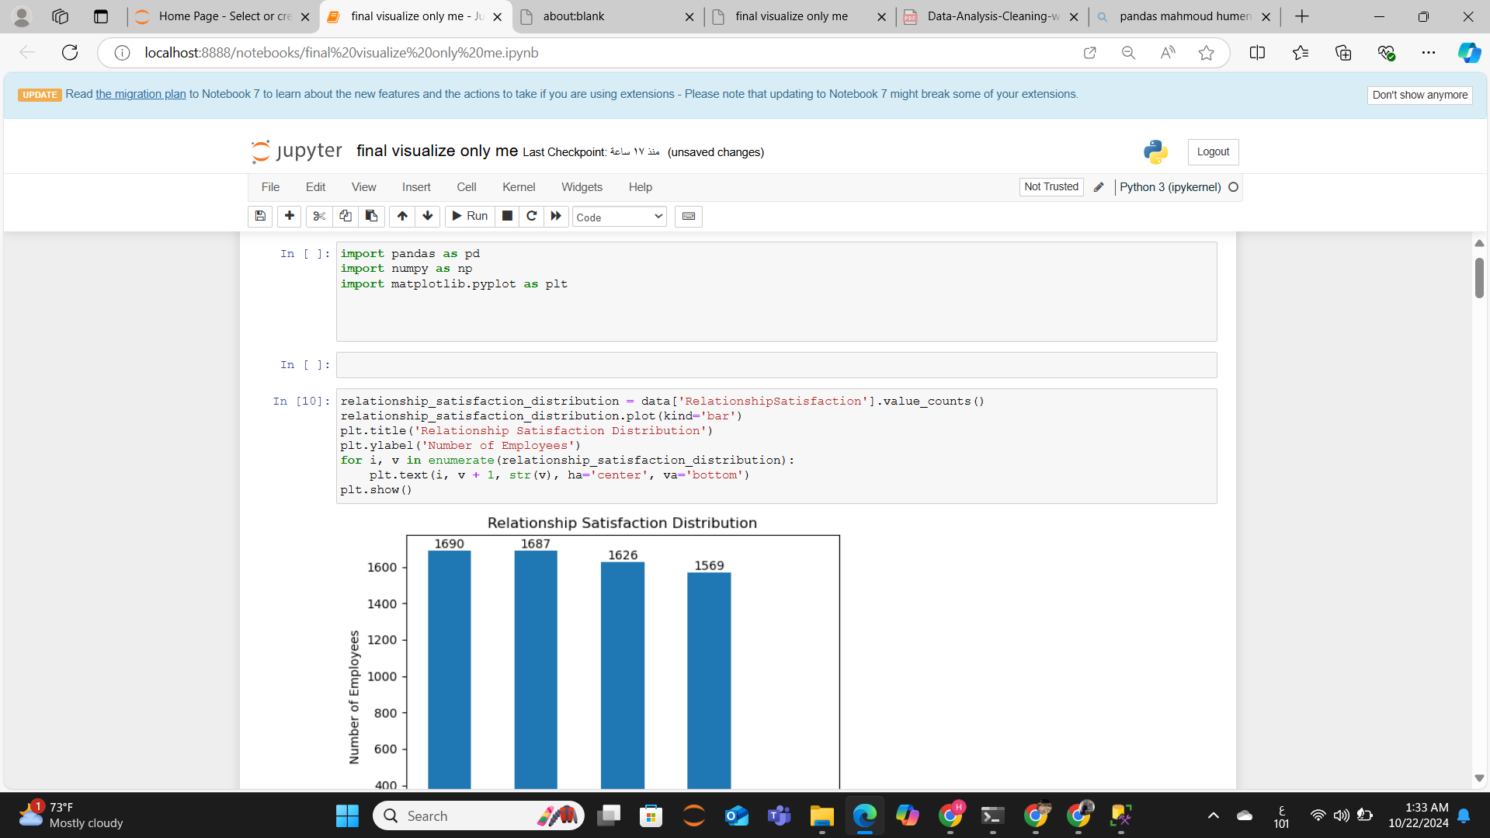

Slide 14
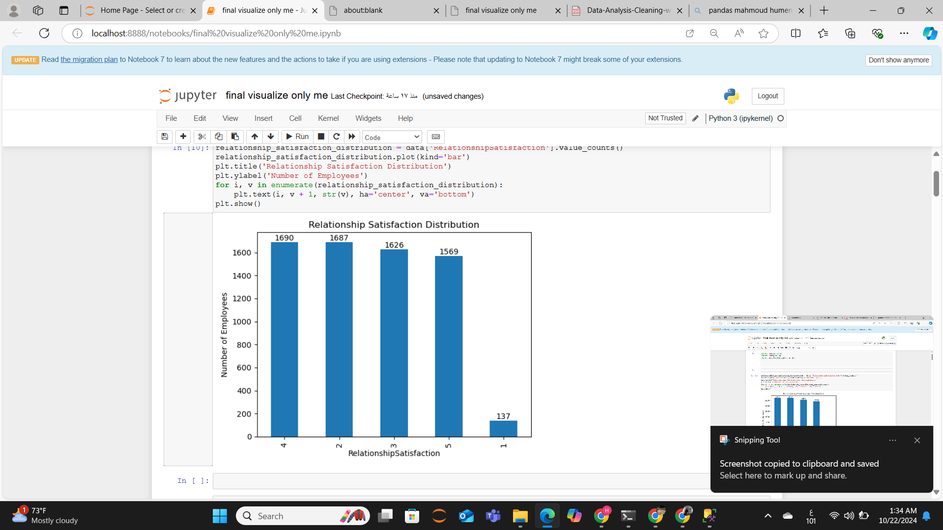

Slide 15
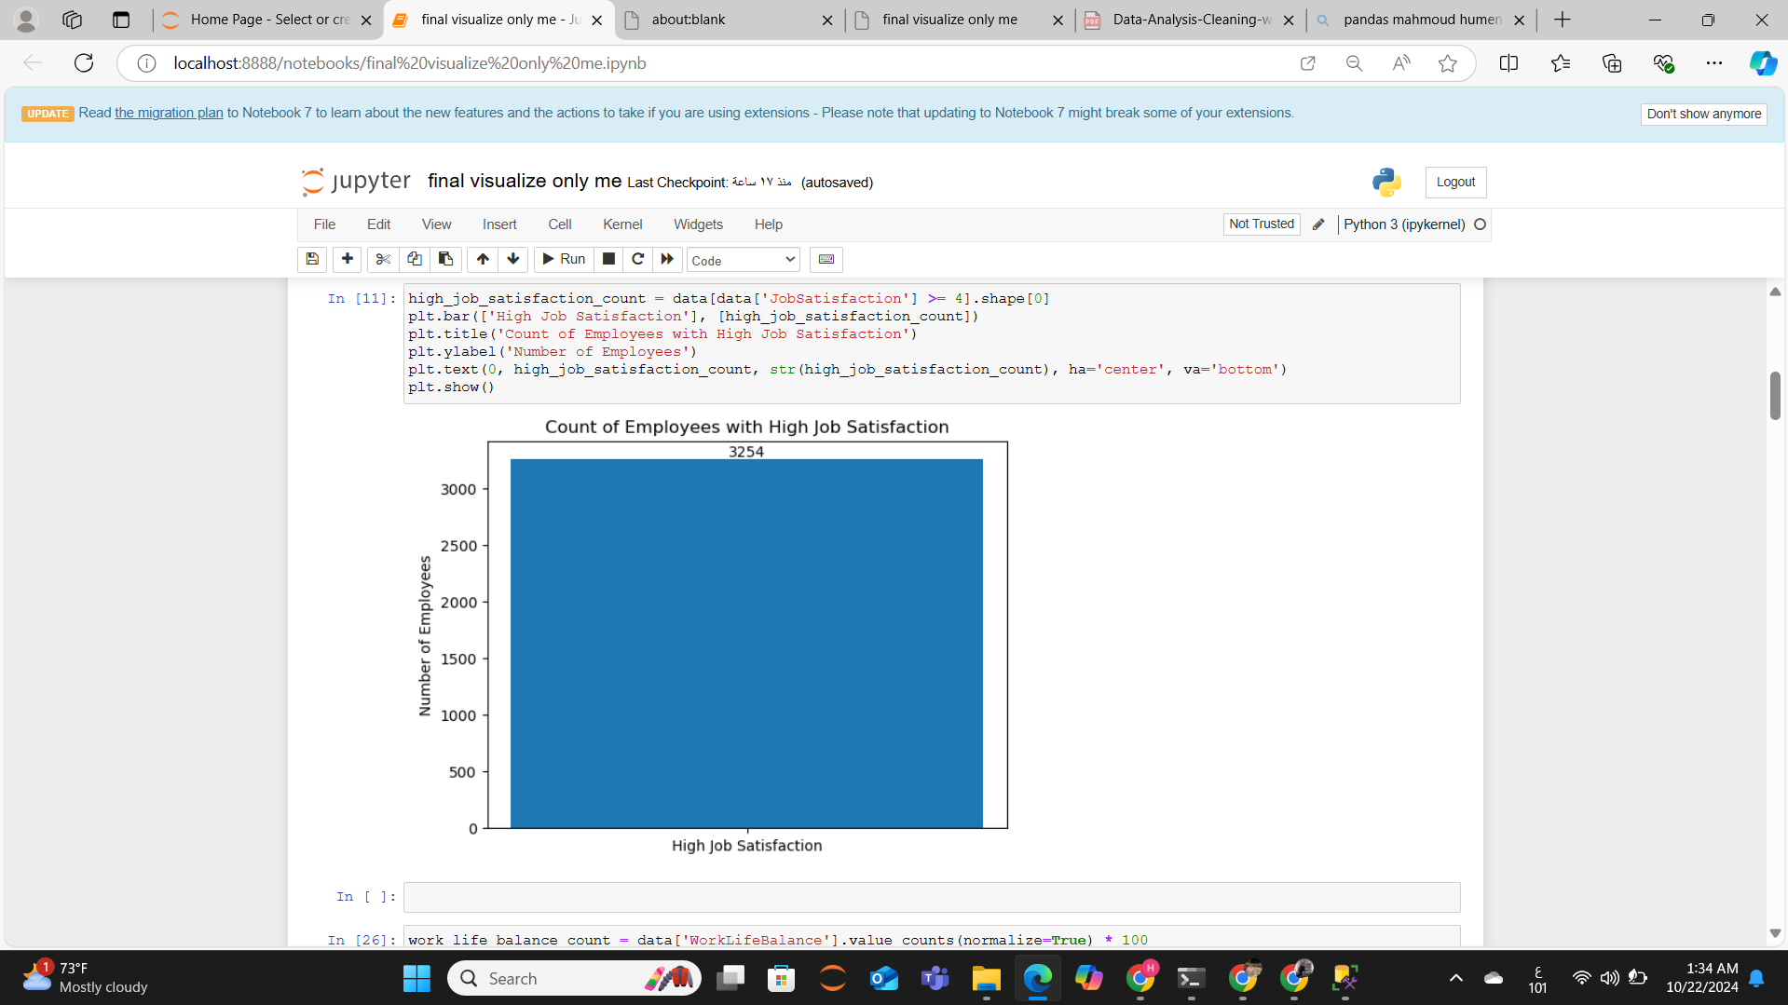

Slide 16
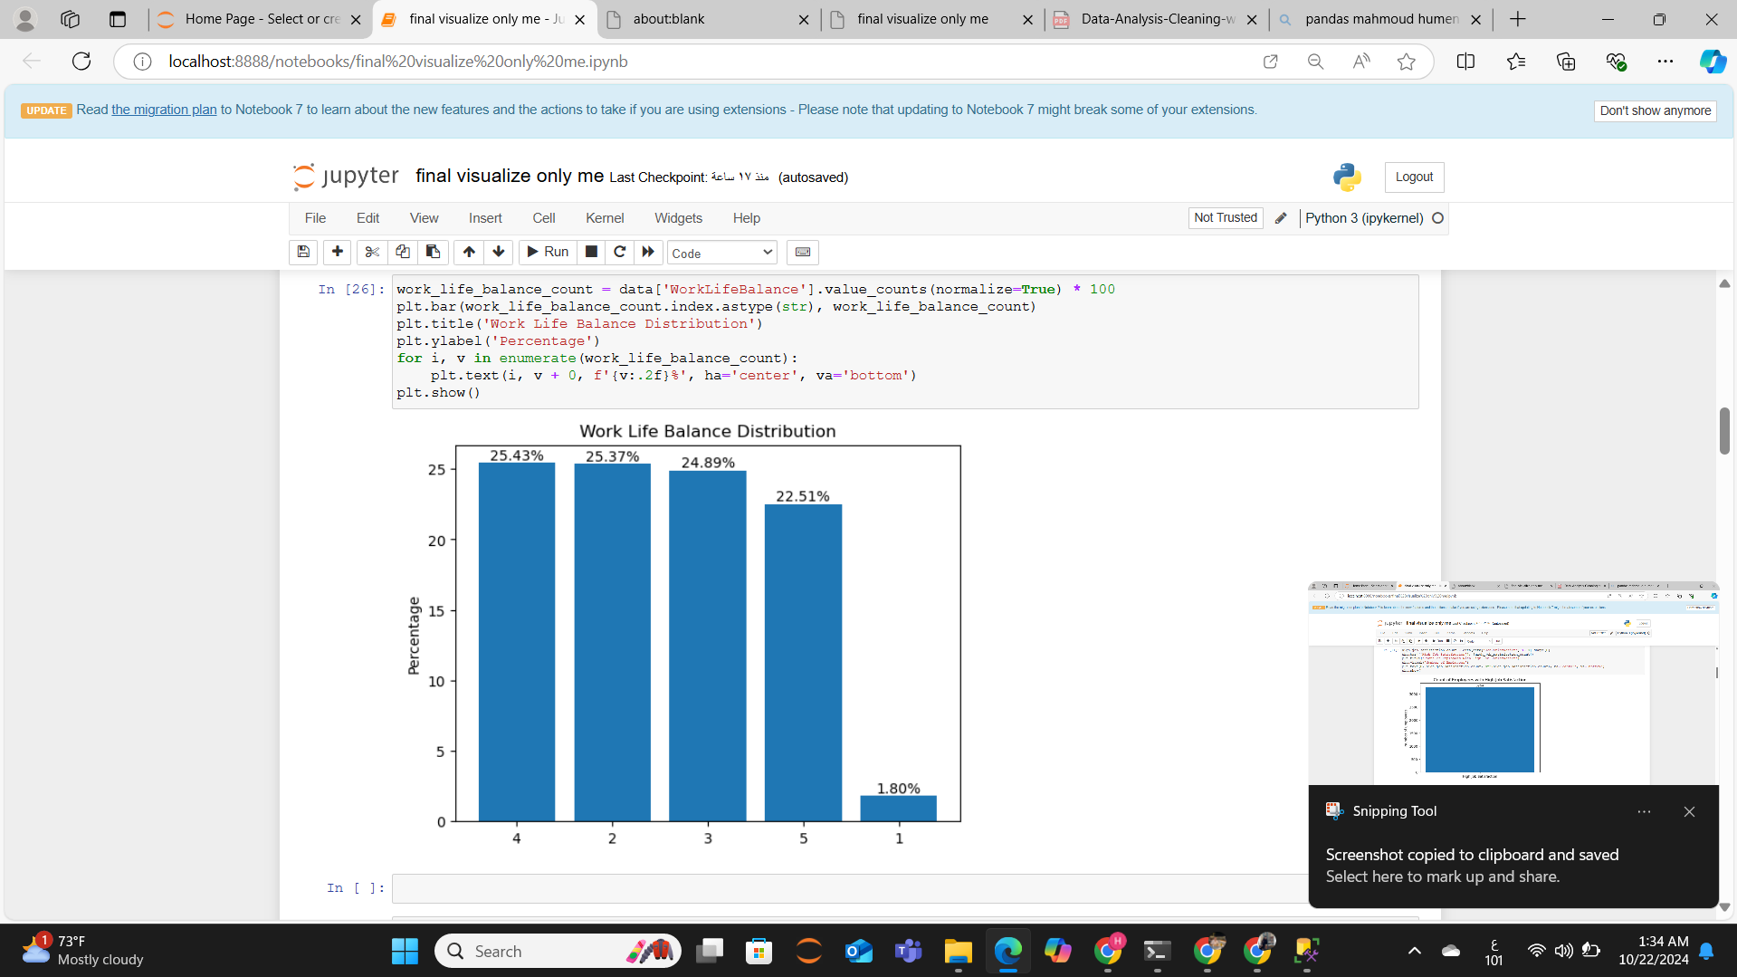

Slide 17
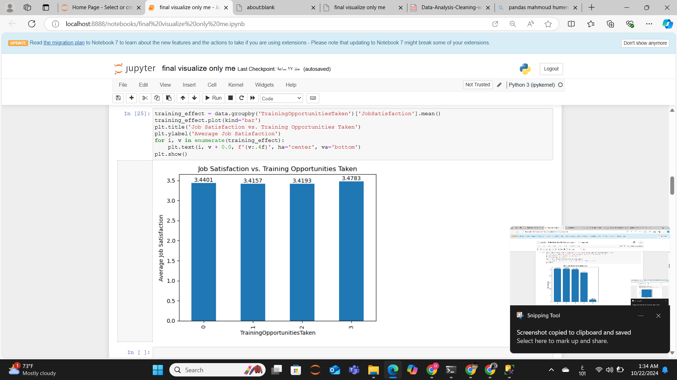

Slide 18
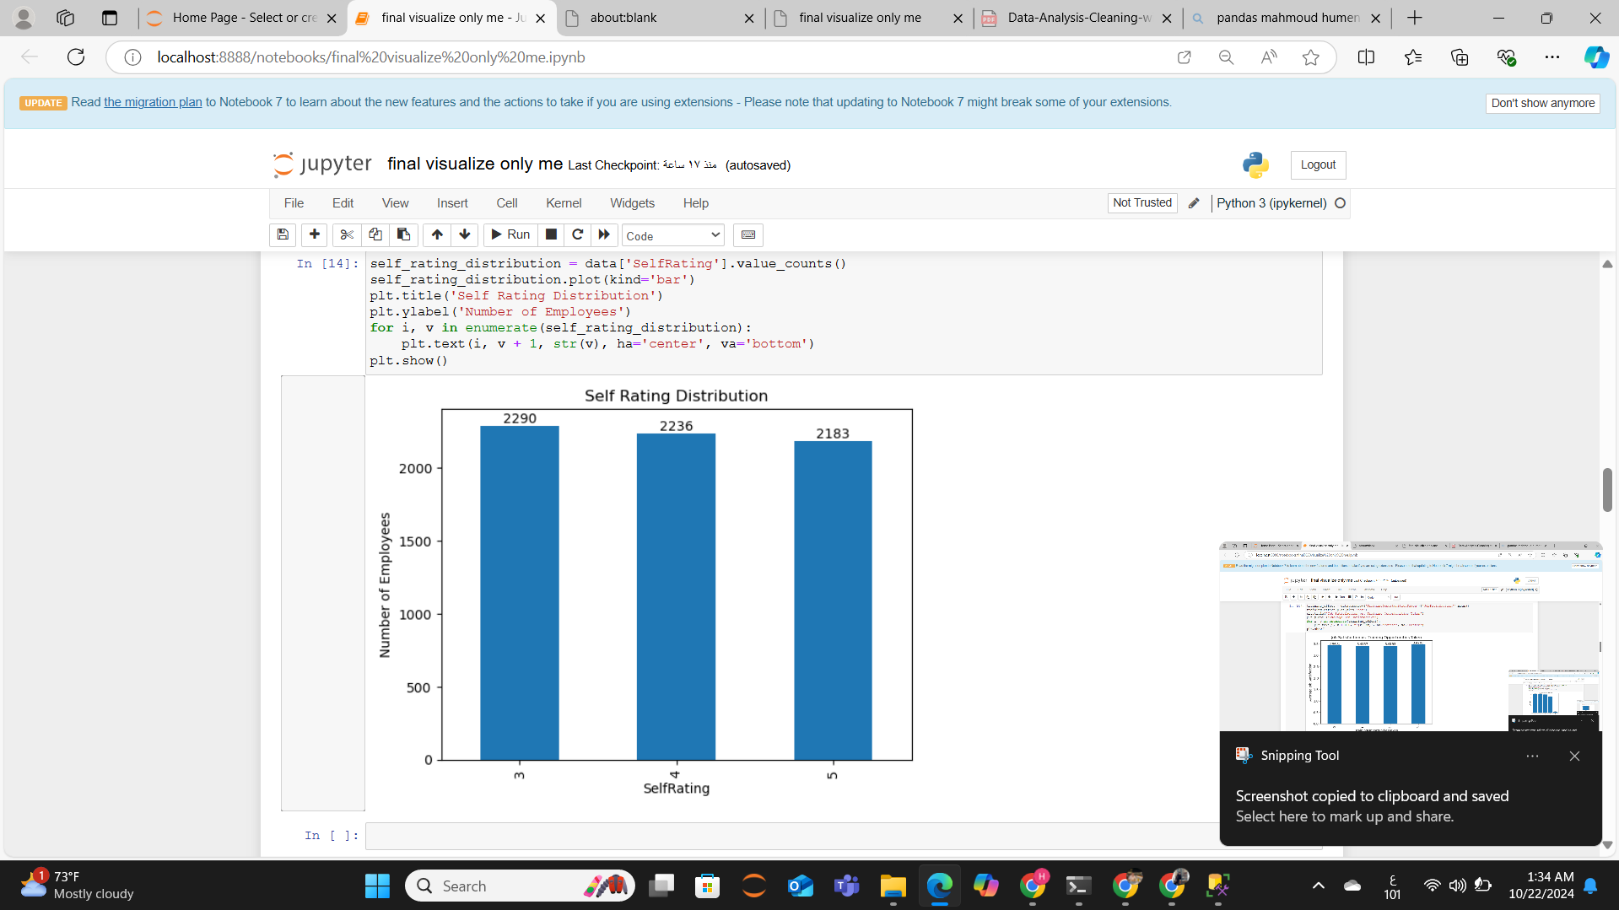

Slide 19
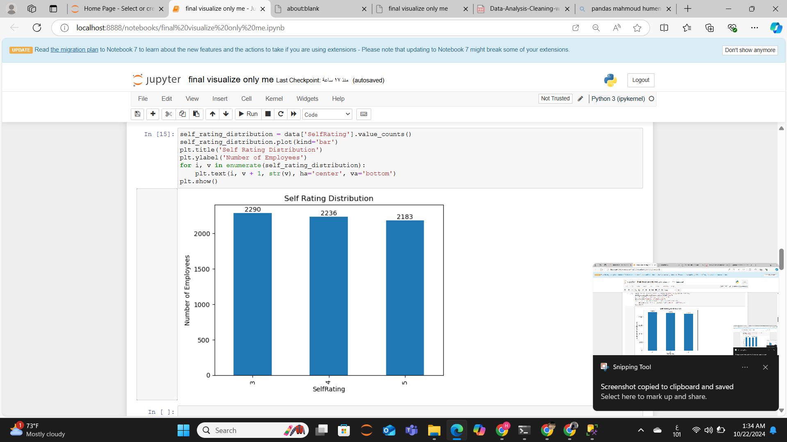

Slide 20
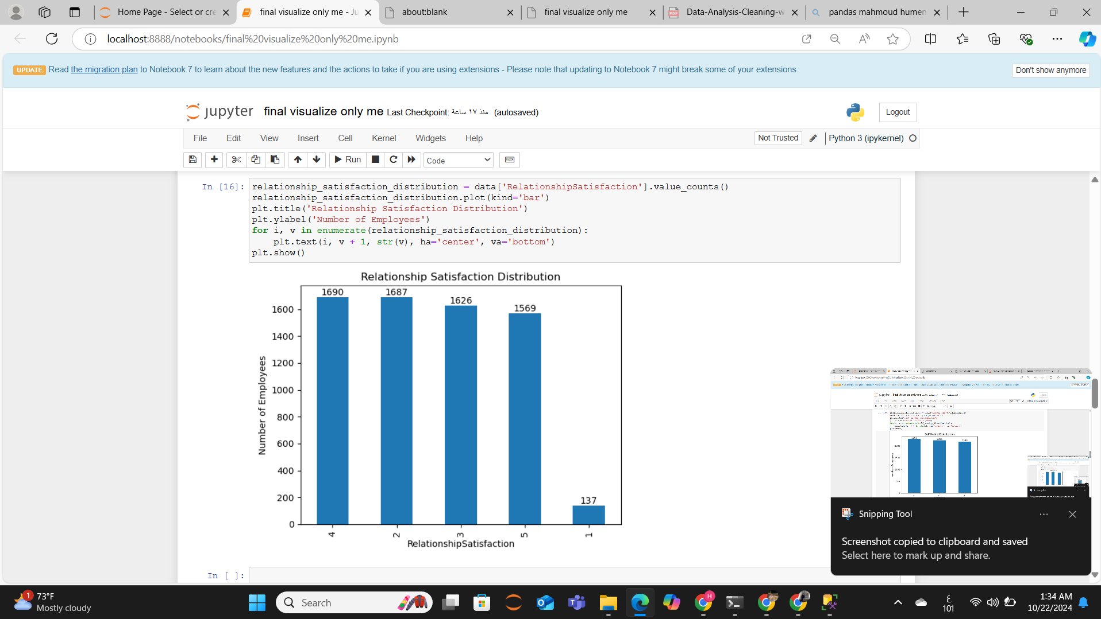

Slide 21


Slide 22
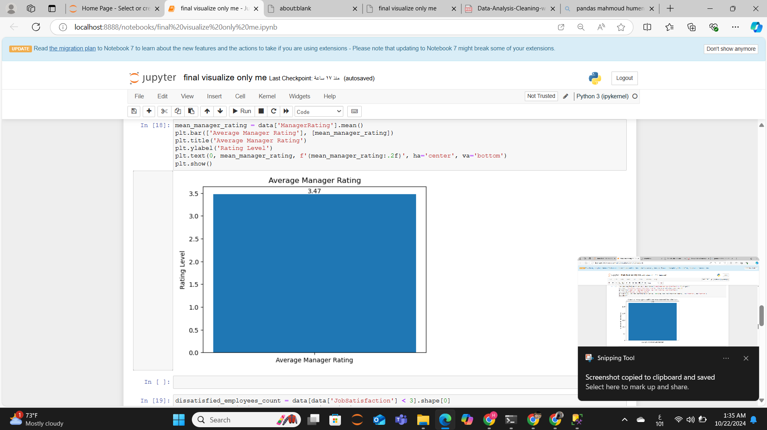

Slide 23
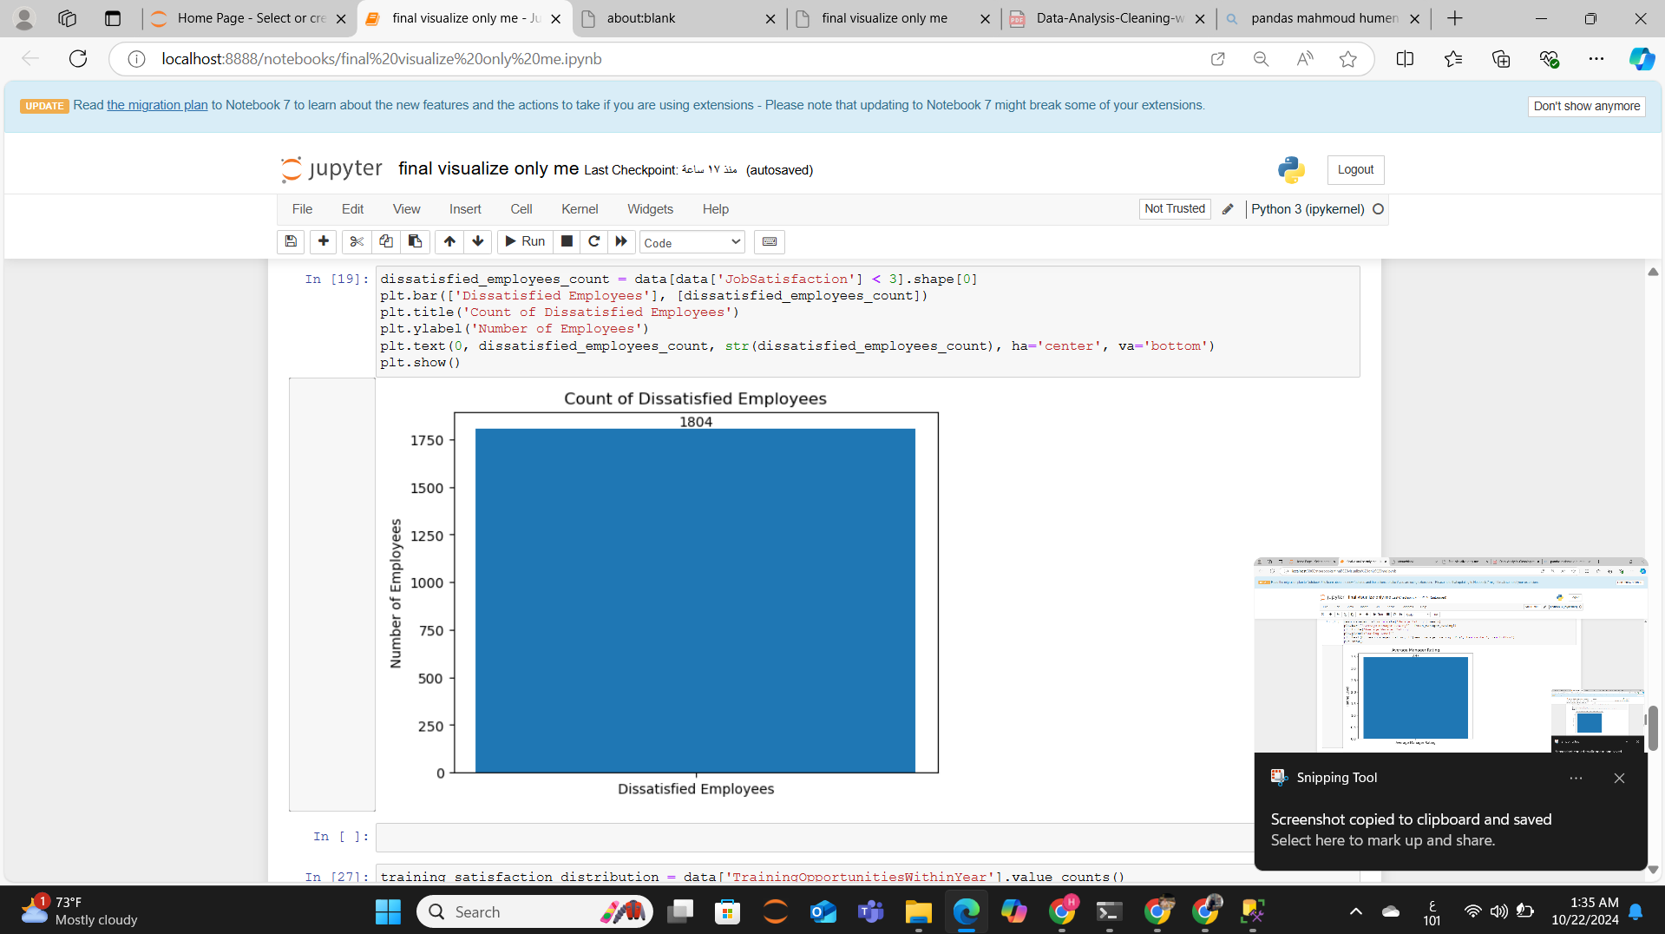

Slide 24
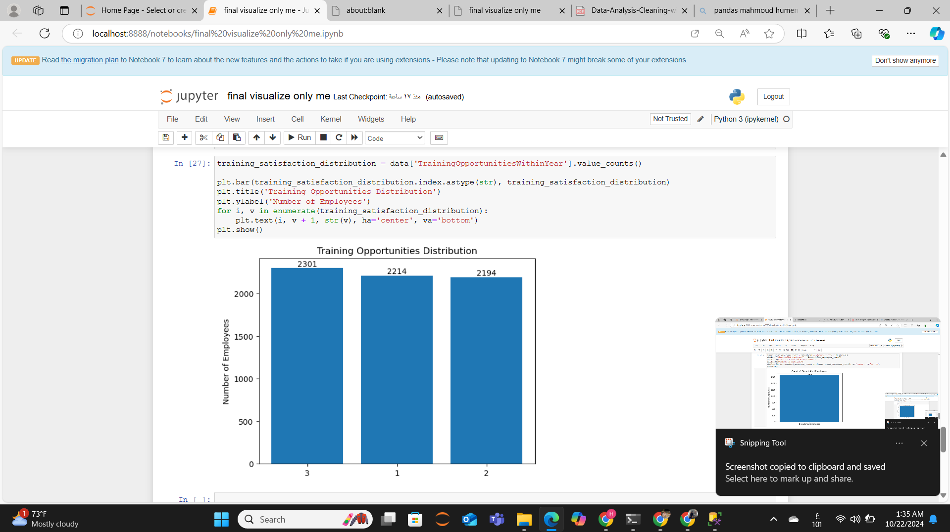

Slide 25
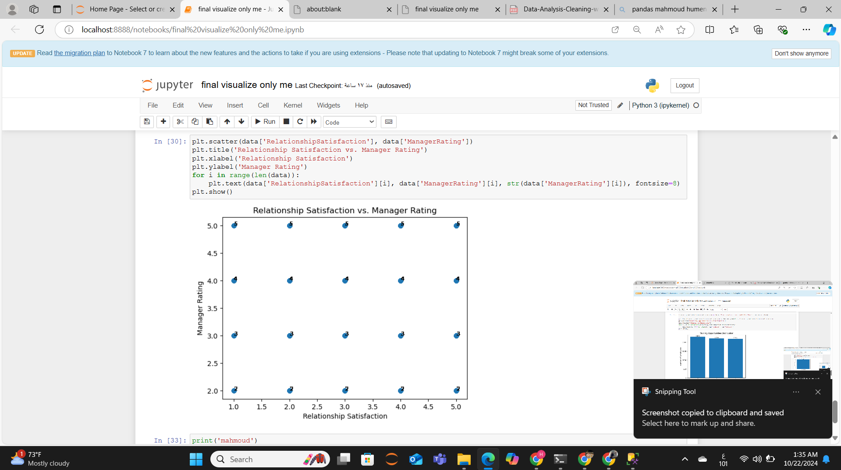

Slide 26




Transitioning to Data Visualization
Clean Data
Exploratory Analysis
Communicate Insights
Create visually engaging and informative data visualizations to effectively communicate your findings to stakeholders and decision-makers.
Properly cleaned and organized data is the foundation for effective data visualization, ensuring the accuracy and reliability of your insights.
Use visualization techniques to uncover patterns, trends, and relationships within your data, guiding your decision-making process.

Slide 27





Introducing Python for Data Visualization
Matplotlib
Seaborn
A comprehensive library for creating static, publication-quality visualizations, offering a wide range of chart types and customization options.
A data visualization library built on top of Matplotlib, providing a higher-level interface for creating attractive and informative statistical graphics.
Plotly
Bokeh
A powerful library for creating interactive, web-based data visualizations that can be easily shared and embedded in web applications.
A library for creating interactive, browser-based visualizations that can handle large and complex datasets with ease.

Slide 28
Powerful Python Libraries for Visualization
Matplotlib
Seaborn
Plotly
Matplotlib is a comprehensive library that provides a wide range of chart types, from simple line plots to complex, multi-layered visualizations. It offers extensive customization options, making it a popular choice for creating publication-quality figures.
Seaborn is a high-level data visualization library that builds on top of Matplotlib, providing a more intuitive and aesthetically pleasing interface. It is particularly well-suited for creating statistical graphics, such as scatter plots, bar plots, and heatmaps.
Plotly is a powerful library that specializes in creating interactive, web-based data visualizations. It supports a wide range of chart types, including 3D plots, maps, and interactive dashboards, making it a great choice for creating visually stunning and engaging visualizations.

Slide 29
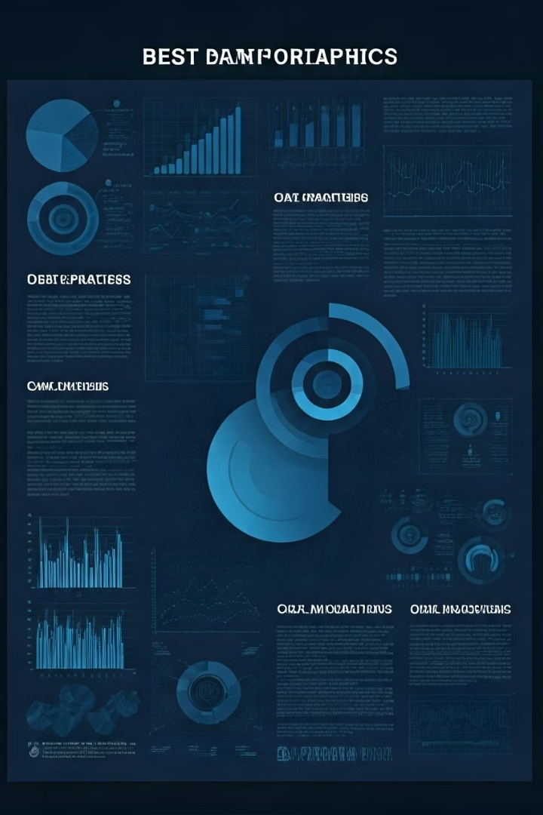
Crafting Compelling Data Visualizations
1
Choose the Right Chart Type
2
Optimize for Clarity
Use clear and concise labeling, appropriate color palettes, and effective use of whitespace to create visualizations that are easy to interpret and digest.
Select the most appropriate chart type for your data and the insights you want to convey, ensuring your visualizations are clear, informative, and easy to understand.
3
Tell a Story
4
Iterative Refinement
Craft a narrative around your data, guiding your audience through the key insights and trends, and helping them make informed decisions.
Continuously test and refine your visualizations, incorporating feedback and best practices to create the most impactful and engaging data stories.

Slide 30

Conclusion and Key Takeaways
In this presentation, we've explored the critical role of data analysis in today's data-driven business landscape. We've learned how to leverage SQL for effective data cleaning, ensuring the integrity and reliability of our datasets. We've also delved into the world of Python data visualization, showcasing the powerful libraries and techniques for creating compelling and informative data stories.
By mastering these skills, you'll be well-equipped to unlock the full potential of your data and drive informed decision-making within your organization. Remember, the journey of data analysis and visualization is an iterative one, so continue to explore, experiment, and refine your techniques to stay ahead of the curve.

